Slide 1
USB Device Activity Monitor
SDN260S · SOFTWARE DESIGN 2 · GROUP 37
Detect, log and flag USB drives in Java
Thato Ernest · Tumisang Mainaakae · Ashwill Visagie · Kwalunga Ligwa · Wande Mchwayi
Notes:
Thato: introduce the project and all five members. Keep it under 1 minute.

Slide 2
The problem and our purpose
Risk
Gap
Our tool
USB drives spread malware and leak data within seconds.
Most users keep no record of which devices were plugged in, or when.
Logs every connect and removal, flags untrusted drives, exports reports.
Group 37 · USB Device Activity Monitor
2
Notes:
Thato: state the real-world problem, why it matters, and the purpose of the application.

Slide 3
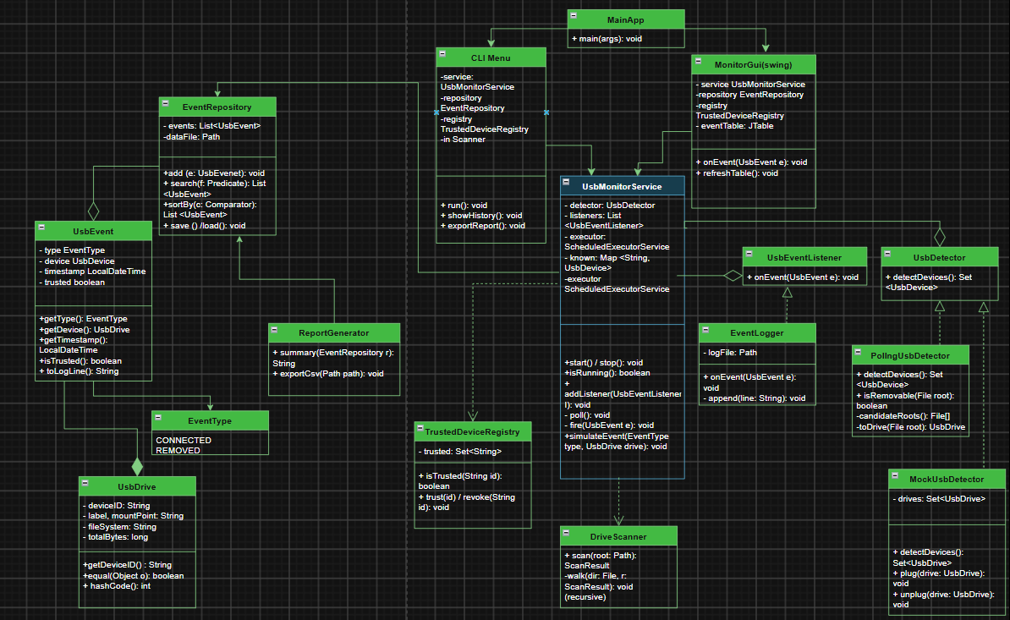
UML class diagram
[Insert your UML class diagram image here]
Group 37 · USB Device Activity Monitor
3
Notes:
Ashwill: walk through the diagram. Start at MainApp, then UsbMonitorService in the centre, then the detectors, listeners and storage classes. Replace the placeholder box with your UML image (Insert image in the editor).

Slide 4
Four packages, one job each
model
service
storage
ui
UsbDrive, UsbEvent, EventType, ScanResult
UsbMonitorService, detectors, EventLogger, TrustedDeviceRegistry, DriveScanner
EventRepository, ReportGenerator
MainApp, CliMenu, MonitorGui
Interfaces
Observer pattern
UsbMonitorService uses the UsbDetector interface. Real or mock detector swaps in.
Each event notifies every UsbEventListener: logger and repository.
Group 37 · USB Device Activity Monitor
4
Notes:
Tumisang: explain the main classes and how they relate. Data flow: poll() every interval, compare drive sets, create UsbEvent, check trusted registry, notify listeners.

Slide 5
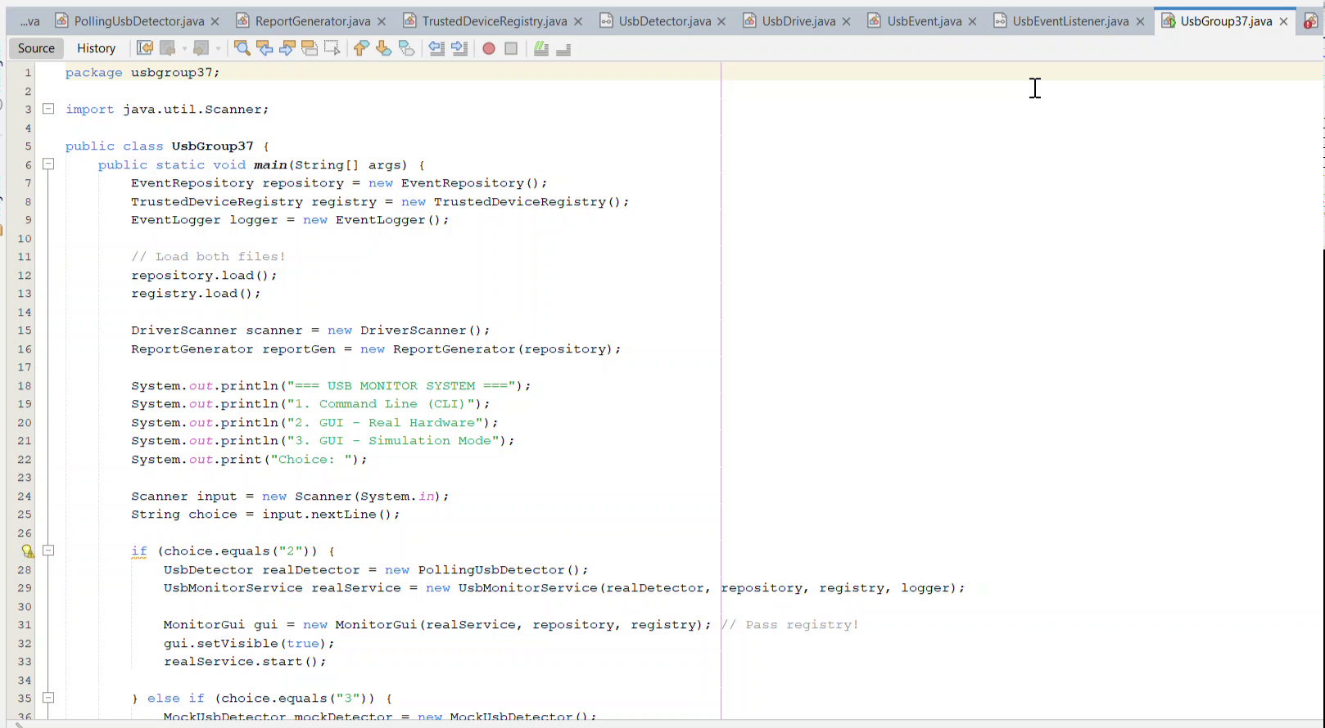
Live demo
Group 37 · USB Device Activity Monitor
5
Notes:
Switch to the screen recording here. Spend about 5 minutes. Show: recursion in DriveScanner, HashSet trust check, ScheduledExecutorService, file handling, serialization.

Slide 6
Testing and challenges
How we tested
Challenges
Real USB drives and a MockUsbDetector. Normal and edge cases: missing path, empty search, empty export.
No native Java USB API, so we poll drive roots. Weak device IDs. Fixed drives listed as USB.
Group 37 · USB Device Activity Monitor
6
Notes:
Kwalunga and Wande: explain testing, challenges and what you did about each. Only claim tests you have re-run and recorded.

Slide 7
What we achieved
Detects and logs USB connect and removal
Flags untrusted devices, exports CSV reports
CLI, Swing GUI and Simulation Mode
GitHub: https://github.com/ogonemainaakae-rgb/File-system-sorter
Group 37 · USB Device Activity Monitor
7
Notes:
Thato: summarise, state future work, show the GitHub link, thank the viewer.

